Slide 1
Medical terminology
Dr Dina Taimeh

Slide 2
Medical terminology
Medical terminology refers to the words and language used specifically in the medical and health fields.
Language used to describe anatomical structures, procedures, conditions, processes and treatments in the medical field.
Medical terminology serves as the universal language of healthcare across a multitude of settings.
Much of learning medical terminology is through memorization and practical application

Slide 3
Importance of medical terminology
Ensures consistent documentation of clinical information
Creates a streamlined system for data entry and retrieval across electronic medical records for billing and insurance purposes
Ensures a consistent understanding of language across the continuum of care
Improves patient care and safety, research and evidence-based medicine
Helps promote efficient communication
Helps create a seamless patient experience

Slide 4
Medical terminology
Inflammation in the heart muscle
Myocarditis
Level of glucose in the blood is higher than normal
Hyperglycaemia

Slide 5
Medical terminology
This common language is essential for:
Interpreting patient records
Understanding diagnoses
Collaborating with colleagues in critical scenarios, like emergencies, complex operations, and intensive care units.

Slide 6
What happens if MT is neglected?
Miscommunication
Delayed Treatment
Medication Errors
Surgical Mistakes
Diagnostic Inaccuracy

Slide 7
Medical terminology
Prefix
Root
Suffix
Prefix: Appears at the beginning of a term and indicates a location, direction, type, quality or quantity.
Root: Can appear at the beginning of the word if prefix is absent, but the root indicates the primary meaning of the medical term.
Suffix: Appears at the end of the word and indicates a specialty, test, procedure, function, disorder or status

Slide 8
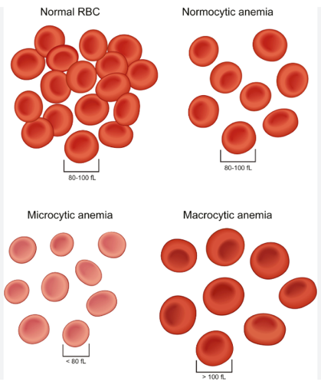
Examples of prefixes
Size
Large | macro-, mega(lo)-
Small | micro
Micro and tiny both contain an “I”
Macro and large both contain an “A”

Slide 9
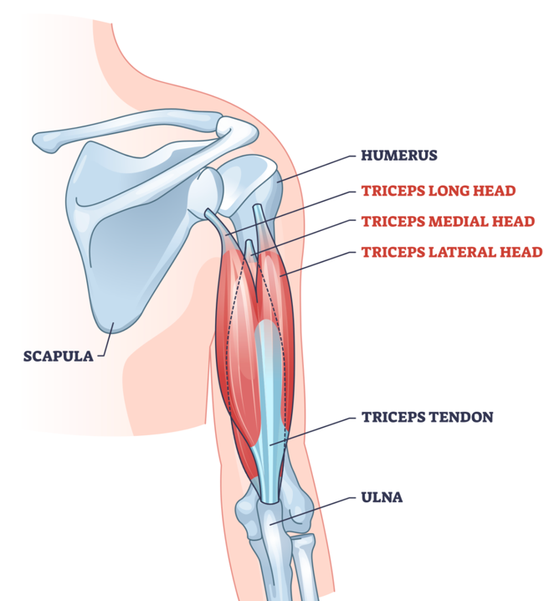
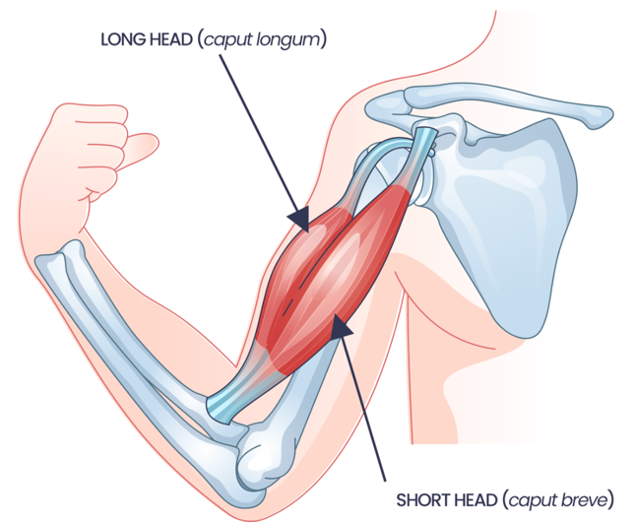
Examples of prefixes
Number
Half | Semi- | Semiconscious
half (one side) | Hemi- | Hemifacial
one | Mono-, uni- | Monotherapy, unicellular
two | three | four | bi- | tri- | qua- | Biceps, triceps, quadriceps
many | Poly- | Polyarthritis

Slide 10
Examples of prefixes
Level
Above normal | Hyper-
Below normal | Hypo-
Hyperthyroidism vs hypothyroidism
Hypertension vs hypotension
Hyperglycaemia vs hypoglycaemia

Slide 11
Examples of prefixes
Time or speed
After | Post-
Before | Pre-
Fast | Tachy-
Slow | Brady-
Postoperative vs preoperative
Prenatal vs postnatal
Tachycardia vs bradycardia

Slide 12
Examples of prefixes
Location
Above | Supra-
Below | Sub-
Between | Inter-
Within | Intra-
Supraorbital fractures
Subcutaneous injections
Intracellular vs intercellular

Slide 13
Examples of root words
 | Root word | Examples
Brain | Enceph- | Encephalopathy
Eye | Ophthalm-, ocul- | Ophthalmic nerve
Skull | Crani- | Cranial nerves, craniectomy
Heart | Cardi- | Cardiovascular system
Bones | Osteo- | Osteomyelitis
Muscles | Myo- | Myocardial infarction
Stomach | Gastr- | Gastric ulcer
Liver | Hepat | Hepatitis
Kidney | Ren-, neph- | Renal failure, nephrolithiasis

Slide 14
Examples of suffixes
 | Suffix | Examples
Study of | -logy | Biology
Removal of | -ectomy | Craniectomy, Appendectomy
Condition of blood | -emia | Anaemia
Inflammation | -itis | Appendicitis
Deficiency | -penia | Neutropenia
Disease | -pathy | Neuropathy

Slide 15
Signs and symptoms
Symptom: subjective evidence of disease or physical disturbance or is a manifestation of disease apparent to the patient himself/herself
Sign: a manifestation of disease that the physician perceives or a something found during a physical exam or as a result of a laboratory or imaging test that shows that a person may have a condition or disease
Examples: pain, high blood glucose, fatigue, nausea, swelling, high blood pressure

Slide 16
Thank you!
Please refer to the accompanying handout for study purposes

